Slide 1
Underground water treatment system for our Head Office Campus
February 2018
Les Hall & Quentin Zevio

Slide 2
Introduction
Woolworths is a SA retailer focusing on high quality clothing & food, trading in over 450 stores in SA & selected African countries.
Woolworths make use of underground water for the majority of the water consumed on our Head Office Campus (located in Cape Town CBD).

Slide 3
Why ?
Our Good Business Journey – “A plan to do business without costing the earth”
An underground water stream flows under the surface of CBD, seeping into our building. To prevent our building from flooding, it was historically pumped into the City’s storm water system and was eventually discharged into the sea.
Our data centre make use of a water cooled A/C system, which runs 24/7 for 365 days
WASTED

Slide 4
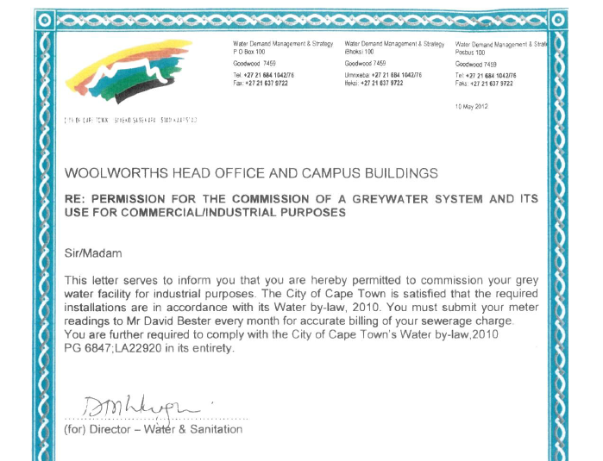
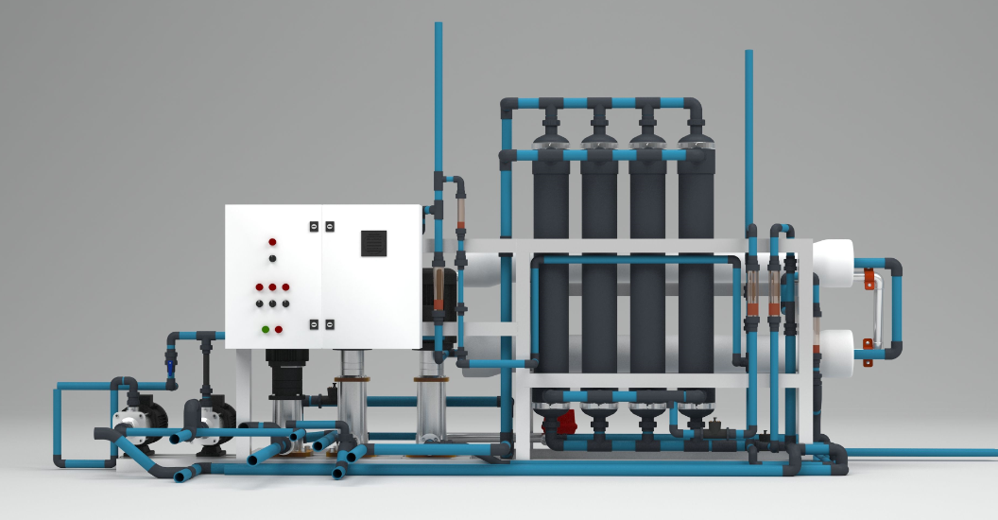
The Project
First phase was commissioned in Oct 2010, supplying treated water for “grey water” use only, i.e cooling towers, sanitation, car wash, fountains & hairdresser.
It was then extended to all buildings of the campus until 2015 and we are now applying to council for permission to use it for drinking water as well.
The system has a capacity of 90kL/day and offers 155kL of storage, distributed across the different buildings of the campus.

Slide 5
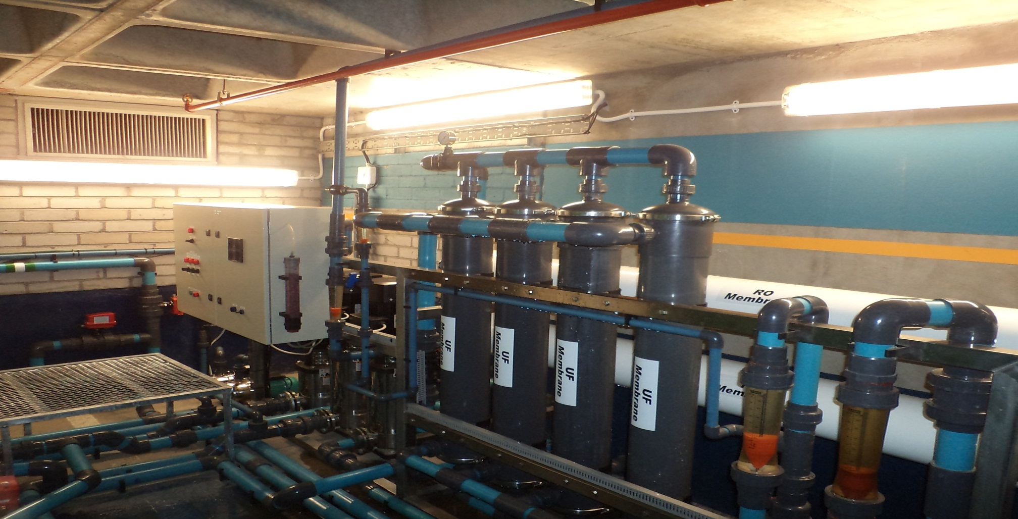

Slide 6
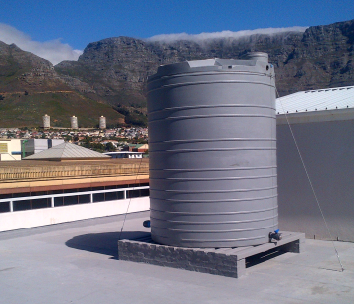
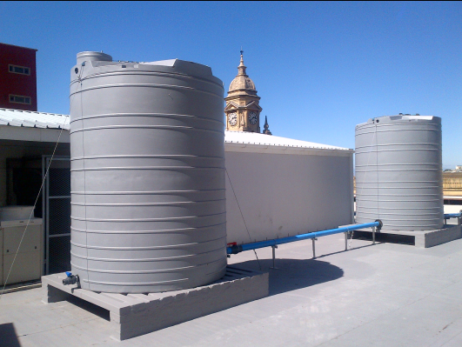
HEAD OFFICE CAMPUS

Slide 7
Water treated to potable quality !
Collection
Raw seepage water from all underground sumps is pumped into a central PVC tank collection point
Ozone Circulation System
Filtration + Reverse Osmosis
Oxidation is calculated to kill all biological entities, including E-coli, Giardia, Cryptosporidium, Legionella and many others
2 sand filters and 1 carbon filter
Chlorination dosing system
In order to keep the distribution lines clean of biological growths
High pressure reverse osmosis

Slide 8
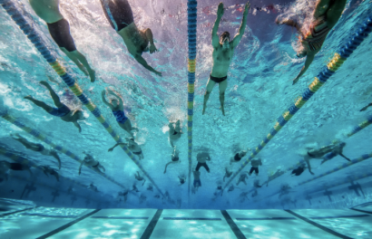
This initiative has helped reduce water consumption since 2010, supplying up to 70% of HO water usage. This is equivalent to 1,2 million litres a month.
This is equivalent to:
OR
8 million cups
of coffee
Two average size
Olympic swimming pools

